Slide 1


Candy Sales Performance Analysis
Product Performance Evaluation with Seasonality and Target Achievement Metrics
Prepared by: Kirti Shaw

Slide 2

CONTENTS
1. Data Overview
2. Chocolate Division Overview
3. Sugar Division Overview
4. Other Candy Division Overview
5. Seasonal Trends
6. Target vs Achieved
7. Conclusion

Slide 3






1. Data Overview
The analysis is based on three datasets:
1
Candy Sales
Order ID, Order Date, City, State, Division, Region, Product Name, Sales, Units, Profit, Cost.
2
Candy Products
Division, Product Name, Unit Price, Unit Cost, Factory
3
Candy Targets
Target vs Achieved for Chocolate, Sugar, and Others.

Slide 4

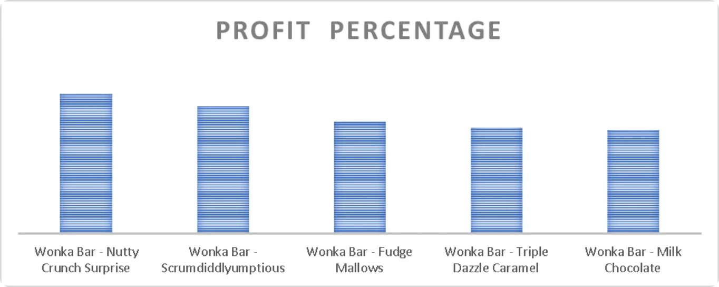

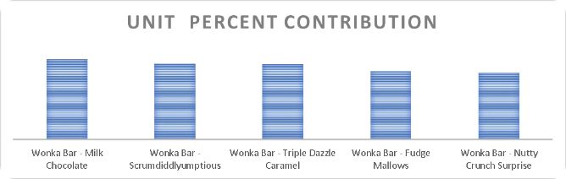
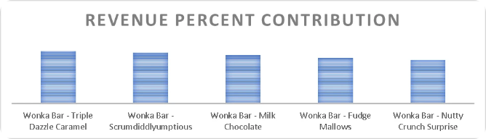
6. Chocolate Division Overview
Insights:
1. Nutty Crunch Surprise
Excellent profit margin but low sales volume, it’s a premium product , focus on marketing and promotions to boost sales.
2. Milk Chocolate
Acts as a key volume driver ,ideal for market penetration, though it offers relatively lower margins.
3. Triple Dazzle Caramel
It is the top revenue generator but it’s profit margin is quite low– a slight price increase may be viable if market conditions allow.

Slide 5

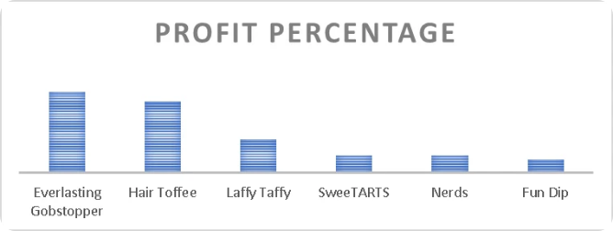
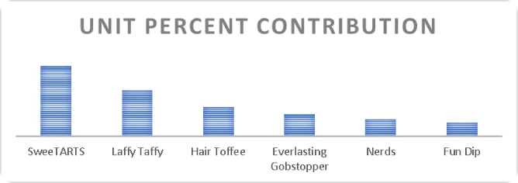
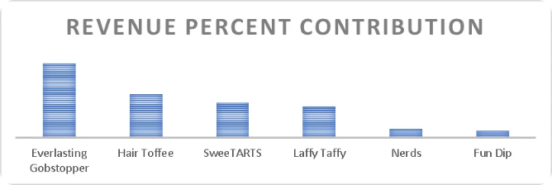
Insights:
Sugar Division Overview
Everlasting Gobstopper
It has high profit plus high revenue but the unit sold is not highest
Strategy : push harder marketing, revisit the price maybe slightly lowering the price can increase unit sales
Sweetarts
It is the volume driver
Strategy: increase the price slightly and introduce premium variants
Laffy Taffy
Popular but not very profitable
Strategy: Check margins, explore cost reduction or bundling with profitable products.
Nerd+Fun Dip
Weakest Performers, they have low demand despite low pricing and profitability.
Strategy : improve product visibility, introduce attractive bundle offers, revamp marketing before phasing them out.

Slide 6
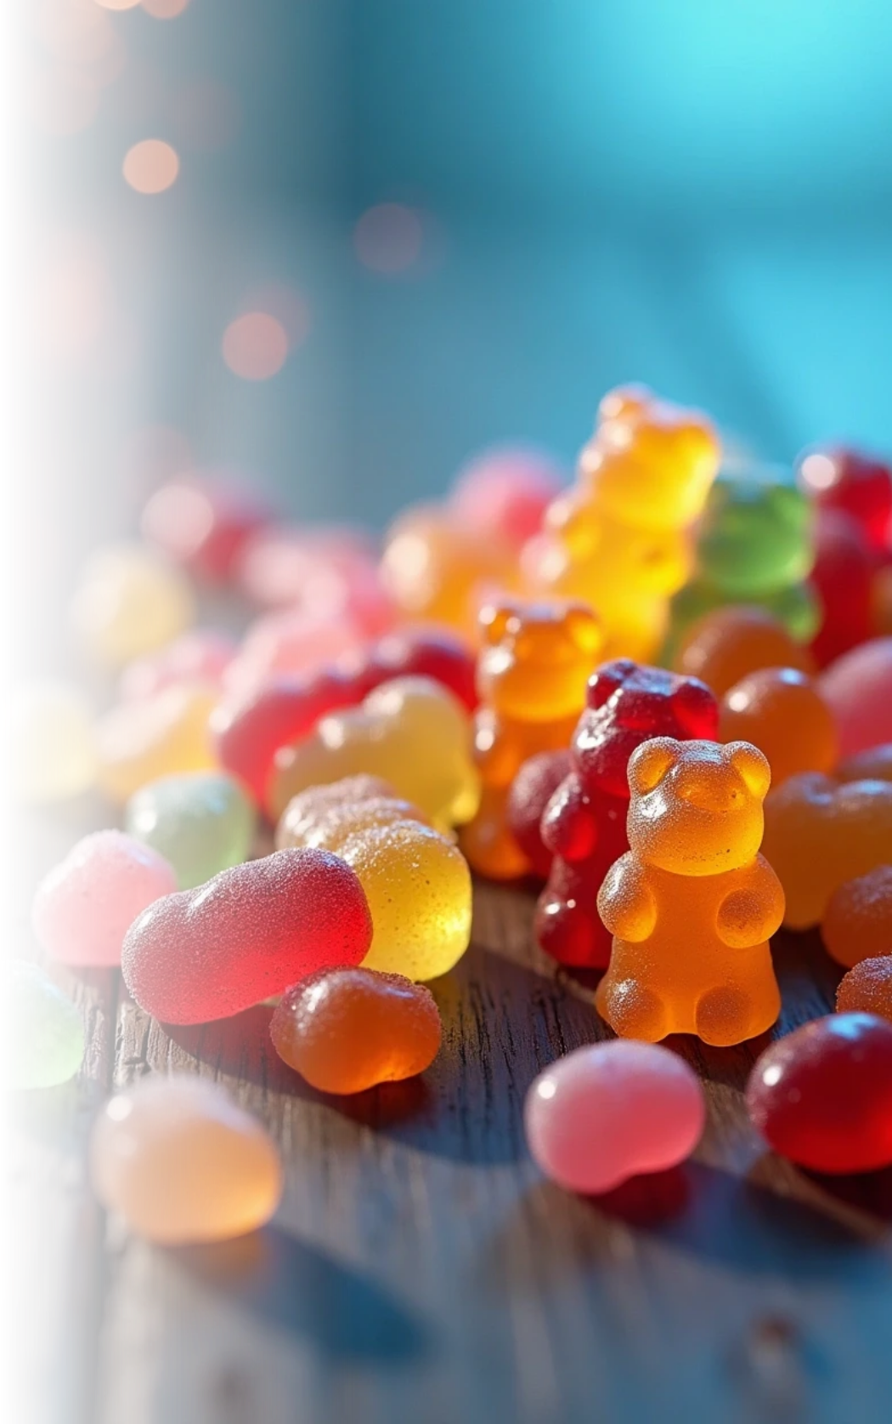

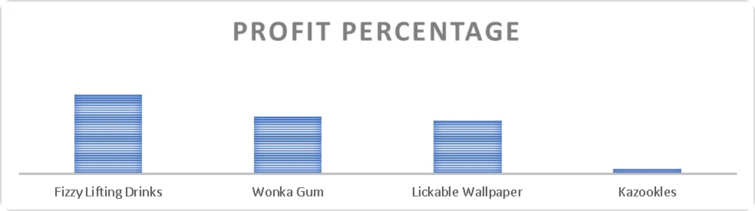
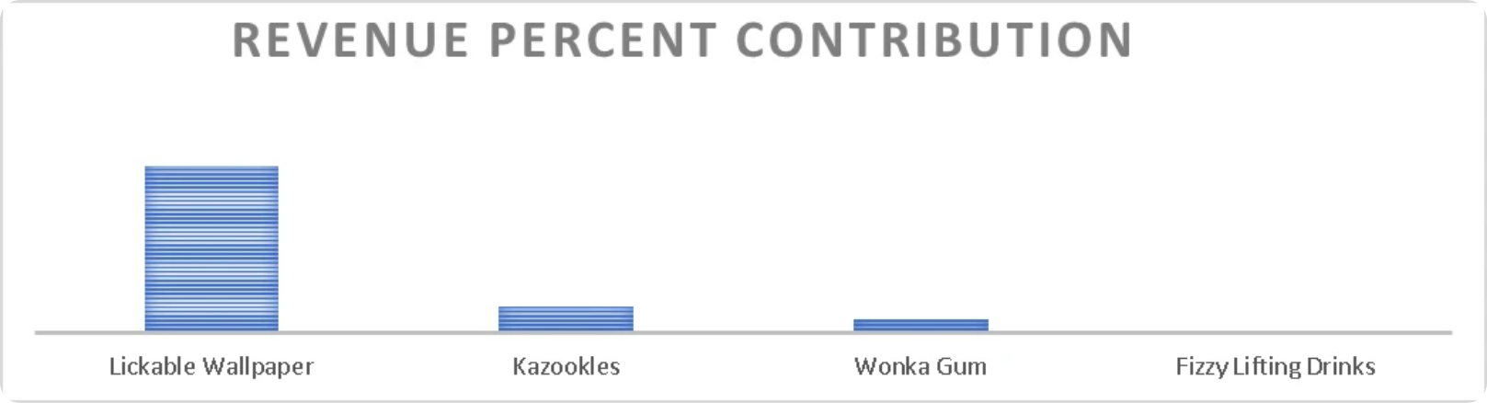
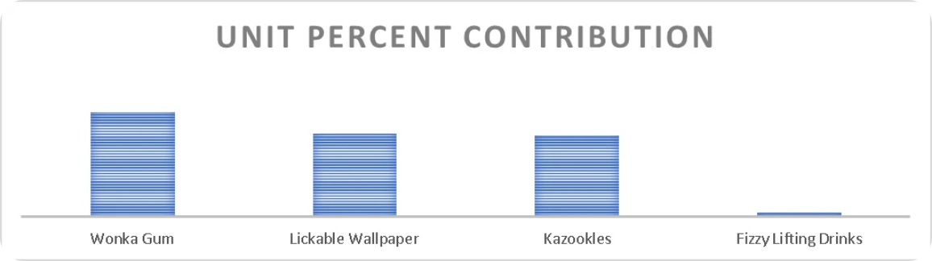
Others Division Overview
Insights:
Fizzy Lifting Drinks
Highest profit Percent but lowest sales volume
Strategy : introduce small trial packs, place them in premium retail channels and leverage influencer marketing to build curiosity and scale demand without price cuts.
Wonka Gum
It’s a high-volume product with strong profitability but limited revenue contribution, indicating underpricing.
Consider a slight price revision or premium variant launch to enhance revenue without hurting demand.
Kazooldes
It delivers strong revenue but suffers from lowest profitability, indicating high cost or discount-driven sales, optimizing production expenses and reassessing pricing can help improve margins.

Slide 7

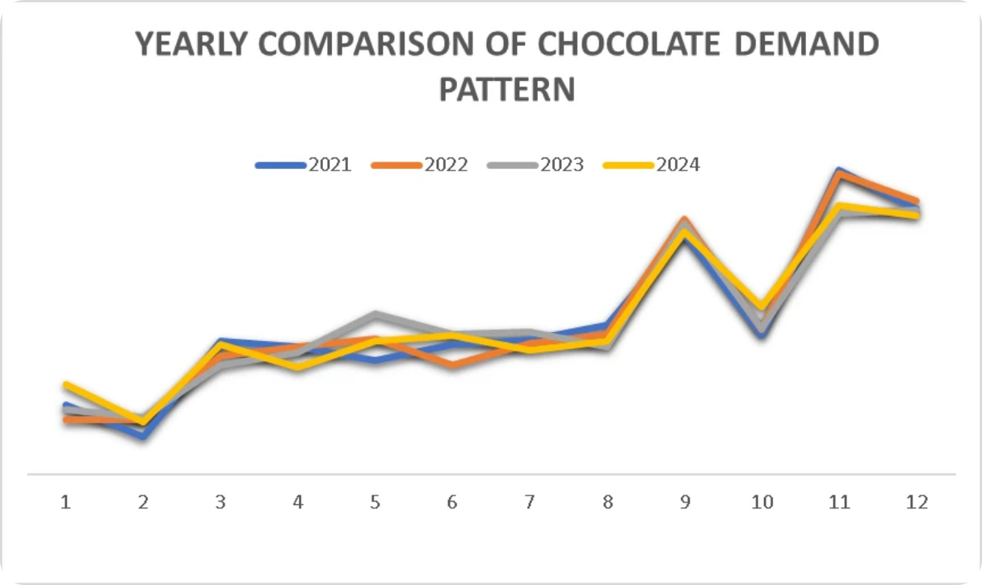
Seasonal Demand Pattern for Chocolate Segment &Strategic Actions
Insight:
The Chocolate Segment displays a highly predictable , stable , and growing seasonal pattern. The demand is consistently U-shaped , characterized by four key seasonal peaks (Month 3,7,9 and 11) followed by clear dips, with month 11 serving as the highest annual peak.
Strategic Actions:
Inventory and Production Planning
Increase production and stock levels head of months 3, 9, and 11 to meet high seasonal demand efficiently.
Festive Positioning
Launch limited edition or festive – themed packs around peak months to maximize profits during high-demand seasons.

Slide 8
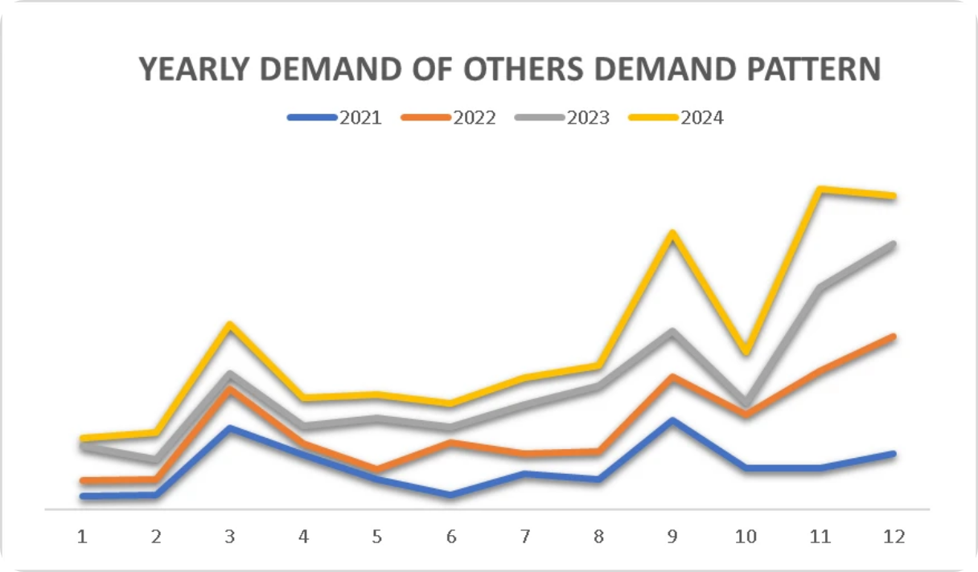
Seasonal Demand Pattern for Others Segment &Strategic Actions
Insight:
This Division shows consistent year-on-year growth in sales, indicating rising overall demand, though intra-year fluctuations persist – with strong peaks in month 3 and 7, followed by dips in months 4-6 and 8-10
Strategic Actions:
Demand Forecasting
Use historical trends to plan inventory and optimize resource allocation.
Seasonal Promotions
Introduce targeted campaigns in weaker months(4-6, 8-10) to maintain momentum.

Slide 9
Seasonal Demand Pattern for Sugar Segment &Strategic Actions
Insight:
Extreme Volatility: Demand is highly inconsistent across the four years, with long periods of near-zero sales (Months 1,2,8,9,10).
Growth Trend: Difficult to determine due to data gaps, but 2024 generally shows stronger demand when data is present
(Months 3,4,6,7,11,12).
Strategic Actions:
Supply Chain De-Risking
Implement advanced, high-confidence forecasting for month 3 and secure long lead inventory to prevent stock-outs during the large volume peaks.
Cross-segment Pull Strategy:
Package sugar products with consistently growing “Others” segment to utilize their stable momentum during volatile periods.

Slide 10
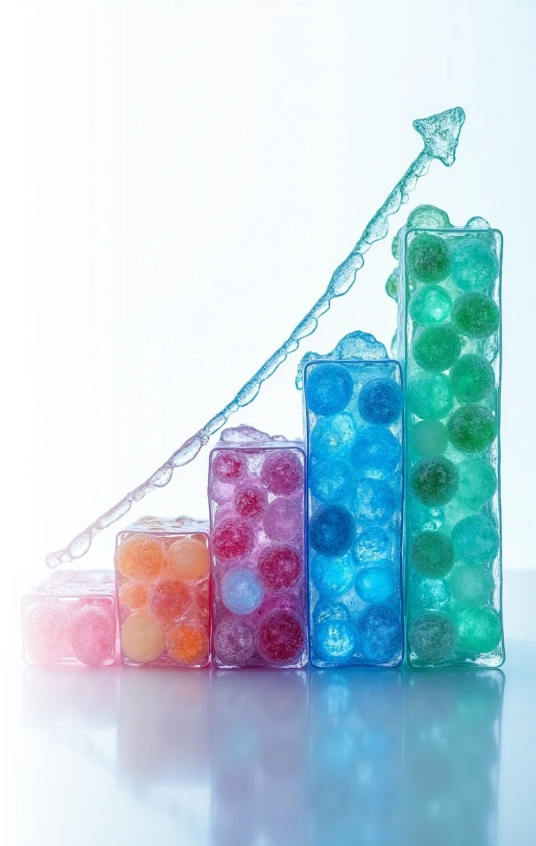
Target vs Achieved
Insights:
Chocolate
Excellent and consistent growth – from 94.72% (2021) to 157% (2024).
 | 2021 | 2022 | 2023 | 2024
CHOCOLATE | 94.72% | 101.45% | 124% | 157%
SUGAR | 0.32% | 0.21% | 1% | 1%
OTHERS | 79.64% | 40.26% | 82% | 111%
Sugar
Extremely weak performance – only 0.32% - 1% (2021-24), showing minimal progress
Others
Fluctuating trend – 79.6% (2021) – 40.3% (2022) – 111% (2024), indicating inconsistency.

Slide 11
Conclusion
Revise Sugar Division
If Targets are high yet achievement remains minimal for 4 years, its signals deep marketing or operational issue s. Reassess targets , marketing campaigns , and market strategy.
Stabilize Others Division
Identify reasons behind fluctuations and build on 2024’s growth drivers to maintain consistency.
Sustain Chocolate Momentum
Maintain current strategies, monitor for cost efficiency, and leverage its success for brand positioning.

Slide 12

Thank You

